Slide 1
Statistical Fundamentals
Autocorrelations

Slide 2
Stationarity, Autocovariance and Autocorrelation Functions in Time Series

Slide 3
Time Series
Forecasts are based on data or observations on the variable of interest. This data is usually in the form of a time series.
Suppose that there are T periods of data available, with period T being the most recent. We will let the observation on this variable at time period t be denoted by y_{t} , t = 1, 2 .... , T.
This variable can represent
a cumulative quantity (such as the total demand for a product during period t) , or
an instantaneous quantity (such as the daily closing price of a specific stock on the BSE).

Slide 4
Forecast Vs Prediction
Generally speaking: Prediction (as in regression), we can extrapolate already built regression model to new subjects not being in the training sample and predict the outcome (dependent variable).
However, in forecasting, we usually look at subject's historical data to build model and then predict certain outcome in future based on the same model.
For instance, based on last 10 days electricity usage, we can forecast usage for the same person in 11-12 day, but not for new people. So, already available forecasting model is unlikely to be used for new subjects

Slide 5
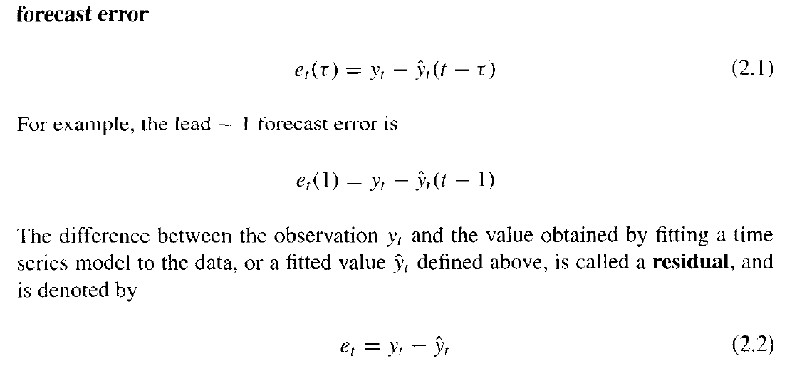
Forecast Error

Slide 6
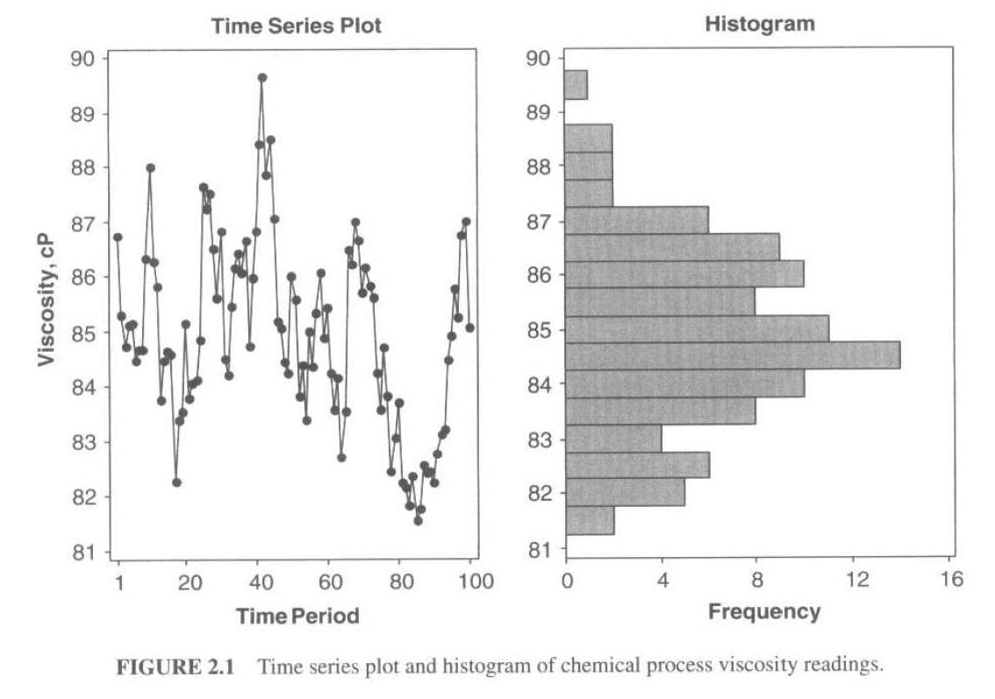
Time Series Plots
Key time-dependent features of the data are lost in histograms, Stem-and-leaf plots and boxplots.

Slide 7
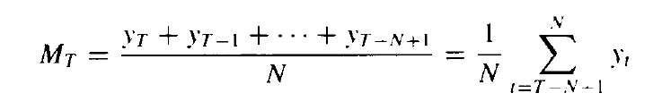
Plotting Smoothed Data
Sometimes it is useful to overlay a smoothed version of the original data on the original time series plot to help reveal patterns in the original data.
There are several types of data smoothers that can be employed.
One of the simplest and most widely used is the ordinary or simple moving average.
A simple moving average of span N assigns weights 1/N to the most recent N observations, and weight zero to all other observations.
M_{T} be the moving average, then the N -span moving average at time period T is

Slide 8
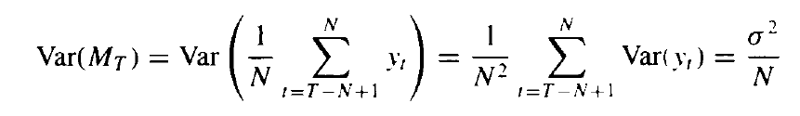
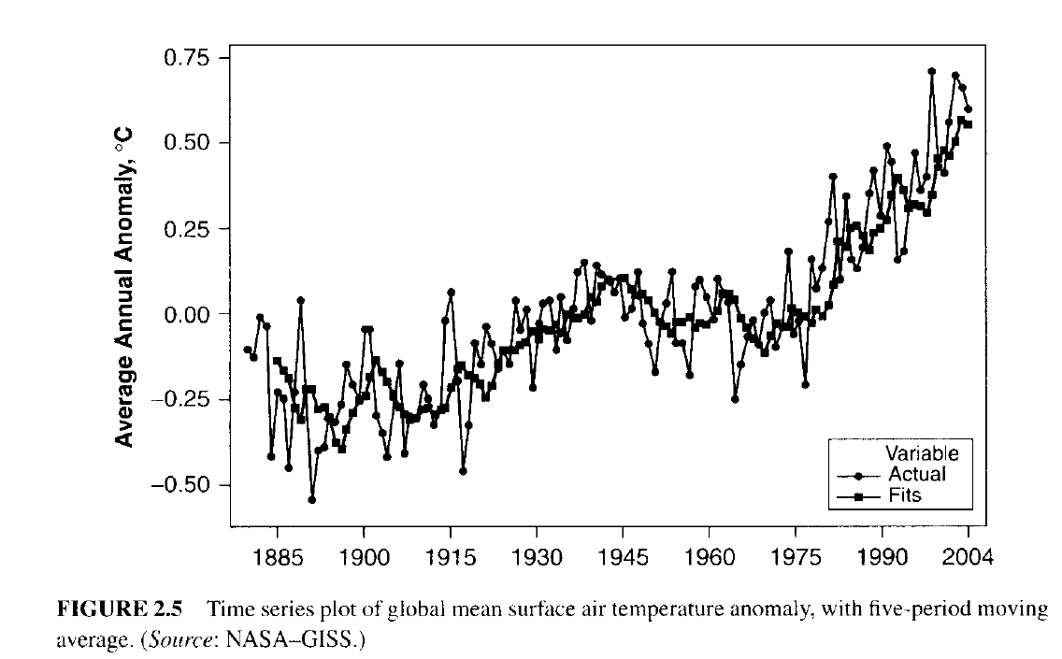
MA has less variability
As each new observation becomes available it is added into the sum from which the MA is computed and the oldest observation is discarded.
The MA has less variability than the original observations: in fact.
The variance of the moving average is

Slide 9
NUMERICAL DESCRIPTION OF TIME SERIES DATA

Slide 10
Stationary Time Series

Slide 11
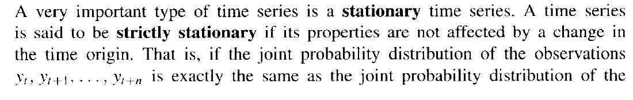

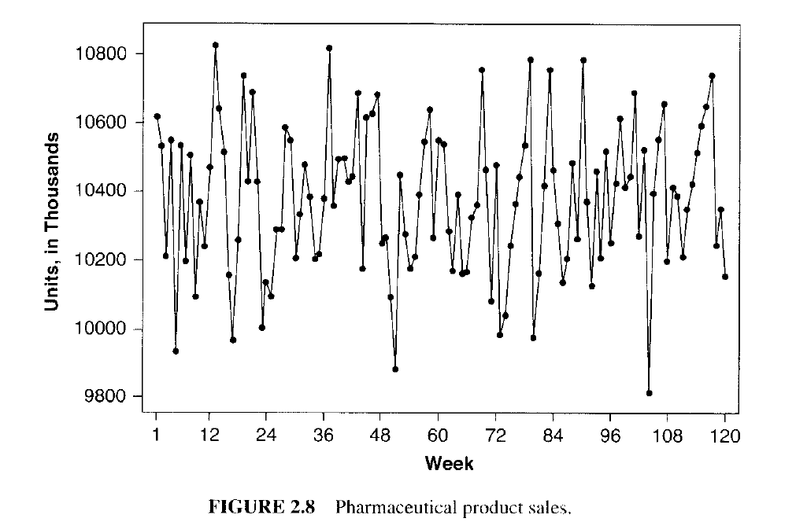
Stationary Time Series
observations =>
the time series is strictly stationary.
Note that both time series seem to vary around a fixed level => this is a characteristic of
stationary time series.

Slide 12
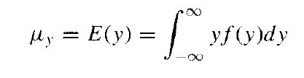
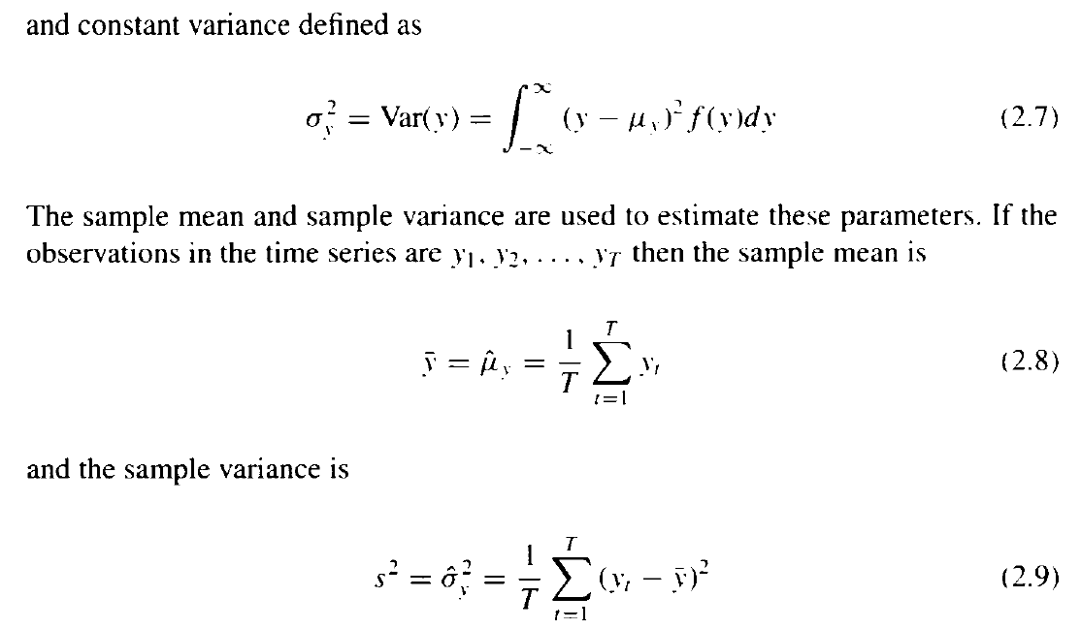
Stationary Time Series
Stationary implies a type of statistical equilibrium or stability in the data. Consequently, the time series has a constant mean defined in the usual way as

Slide 13
Autocovariance and Autocorrelation Functions

Slide 14
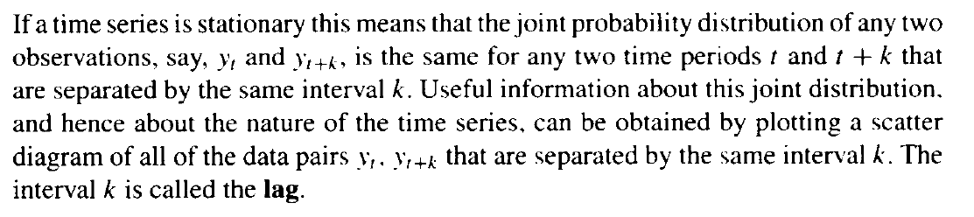
Uncorrelated Vs Correlated

Slide 15
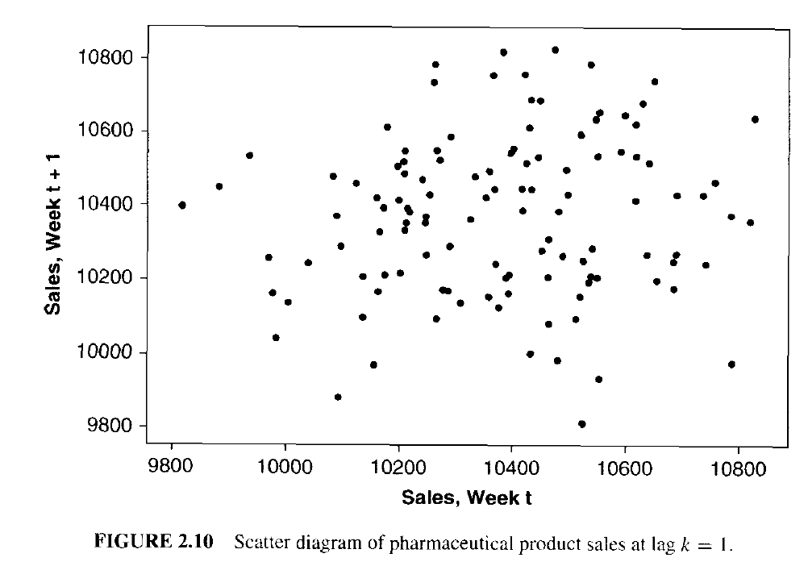
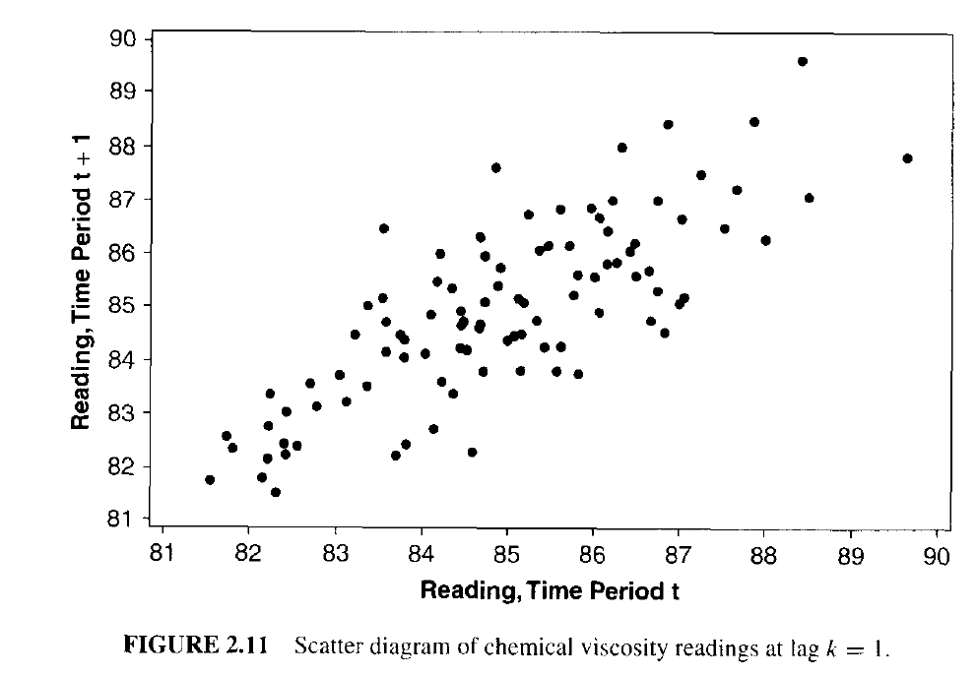
Uncorrelated Vs Correlated
Uncorrelated Vs Correlated
Positively correlated. That is,
a small value of y tends to be followed in the next time period by another small value of y, and
a large value of y tends to be followed immediately by another large value of y.

Slide 16
Autocorrelation

Slide 17
Autocorrelation and ARIMA Models
Ordinary regression models do not account for dependence between values in different periods, which in cross-sectional data is assumed to be absent.
Yet, in the time series context, values in neighboring periods tend to be correlated. Such correlation, called autocorrelation, is informative and can help in improving forecasts.
If we know that a high value tends to be followed by high values (positive autocorrelation), then we can use that to adjust forecasts.
Discuss how to compute the autocorrelation of a series, and how best to utilize the information for improving forecasts.

Slide 18
Computing Autocorrelation
Correlation between values of a time series in neighboring periods is called autocorrelation, because it describes a relationship between the series and itself.
To compute autocorrelation, we compute the correlation between the series and a lagged version of the series.
A lagged series is a “copy” of the original series which is moved forward one or more time periods.
A lagged series with lag-1 is the original series moved forward one time period; a lagged series with lag-2 is the original series moved forward two time periods, etc.

Slide 19
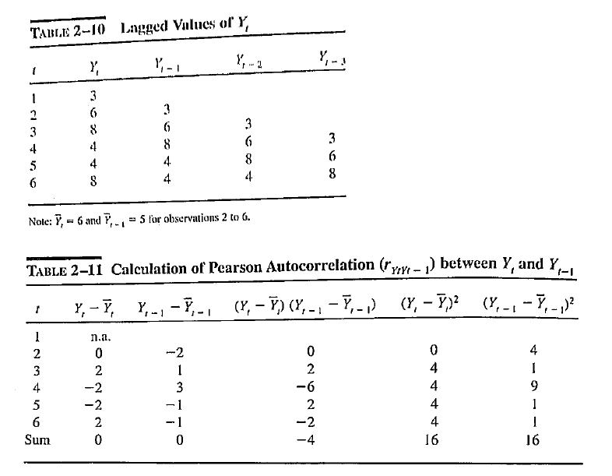
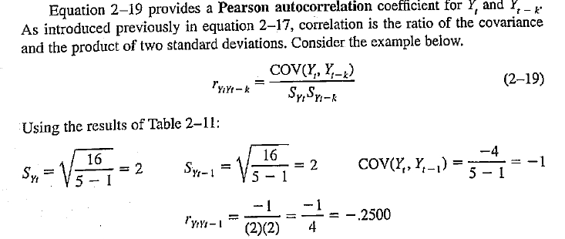
Pearson autocorrelation

Slide 20
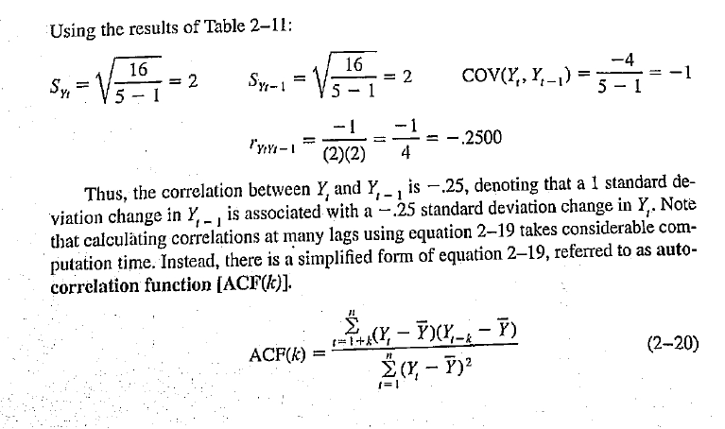
Pearson autocorrelation
Note:
Here one single value of average is used for all. So expect ACF to be different as compared to Pearson correlation coeff at various lags…see next slide

Slide 21
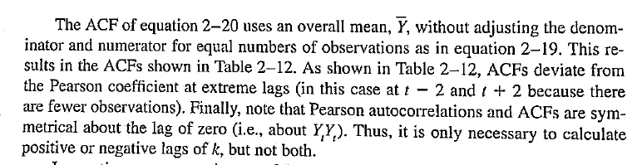
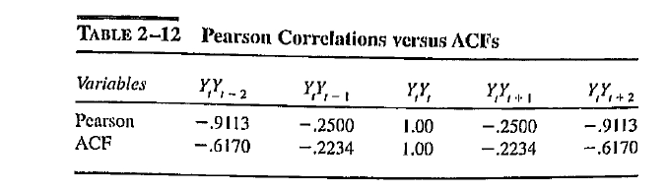
ACF

Slide 22
Before we move on to discuss further analysis of Time series based on Autocorrelation, let us recap the components of time series

Slide 23
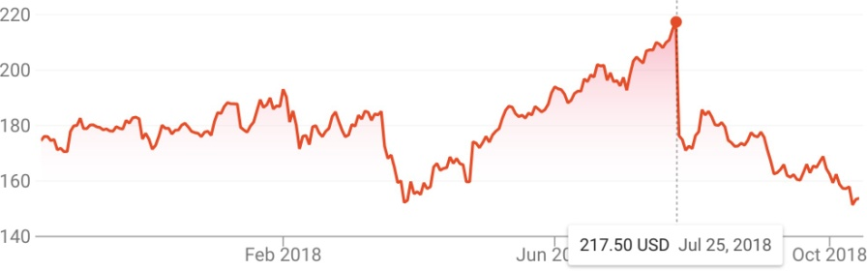
Time Series
A time series is a sequential set of data points, measured typically over successive times.
Time series analysis comprises methods for analyzing time series data in order to extract meaningful statistics and other characteristics of the data.

Slide 24
Components of a Time Series
In general, a time series is affected by four components, i.e. trend, seasonal,cyclical and irregular components.
– Trend
The general tendency of a time series to increase, decrease or stagnate over a long period of time.
110
cents per pound
60 70 80 90
2005 2010 2015
The price of chicken: monthly whole bird spot price, Georgia docks, US cents per pound, August 2001 to July 2016, with fitted linear trend line.

Slide 25
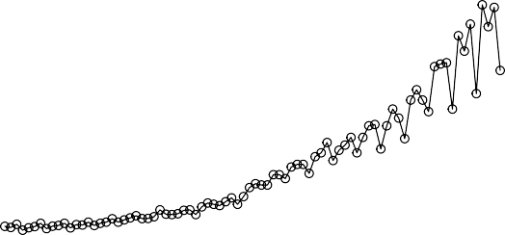
Components of a Time Series (cont.)
In general, a time series is affected by four components, i.e. trend, seasonal,cyclical and irregular components.
– Seasonal variation
This component explains fluctuations within a year during the season, usually caused by climate and weather conditions, customs, traditional habits, etc.
Quarterly Earnings per Share
15
10
5
0
1960 1965 1970 1975 1980
Johnson & Johnson quarterly earnings per share, 84 quarters, 1960-I to 1980-IV.

Slide 26
Components of a Time Series (cont.)
In general, a time series is affected by four components, i.e. trend, seasonal,cyclical and irregular components.
– Cyclical variation
This component describes the medium-term changes caused by circumstances, which repeat in cycles. The duration of a cycle extends over longer period of time.
130
110
90
70
1970 1972 1974 1976 1978 1980
Average weekly cardiovascular mortality in Los Angeles County. There are 508 six-day smoothed averages obtained by filtering daily values over the 10 year period 1970-1979.

Slide 27
Components of a Time Series (cont.)
In general, a time series is affected by four components, i.e. trend, seasonal,cyclical and irregular components.
– Irregular variation
Irregular or random variations in a time series are caused by unpredictable influences, which are not regular and also do not repeat in a particular pattern.
These variations are caused by incidences such as war, strike,
earthquake, flood, revolution, etc.
There is no defined statistical technique for measuring random fluctuations in a time series.

Slide 28
White Noise
What is a White Noise Time Series?
A time series is white noise if the variables are independent and identically distributed (iids) with a mean of zero.
This means that
all variables have the same variance (sigma^2) and
each value has a zero correlation with all other values in the series

Slide 29
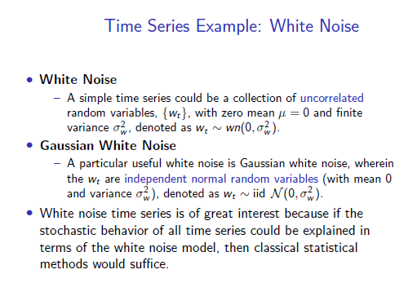

Slide 30
Random Walk
A random walk is another time series model where the current observation is equal to the previous observation with a random step up or down.

Slide 31
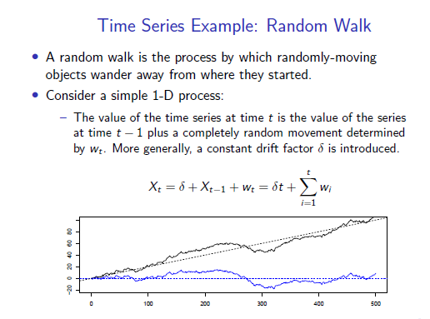

Slide 32
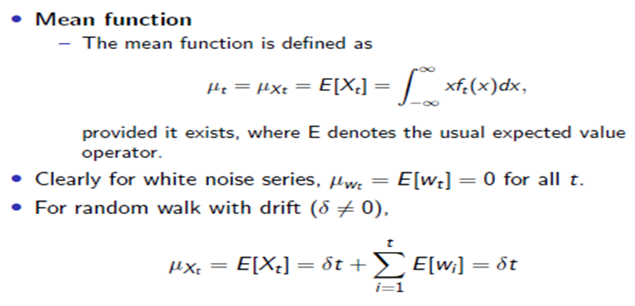
Mean for White Noise and Random Walks

Slide 33
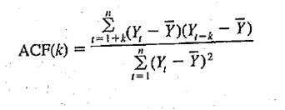
Back to ACF Discussion
Pattern Recognition with ACFs

Slide 34
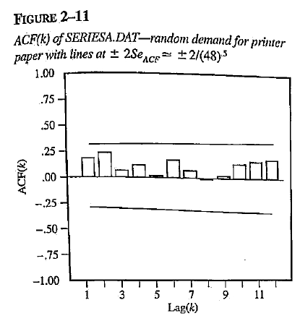
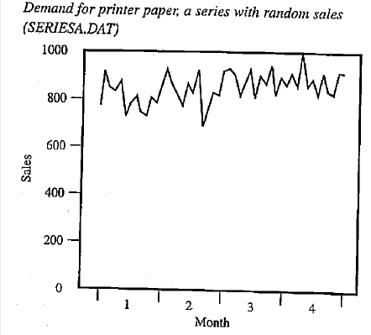

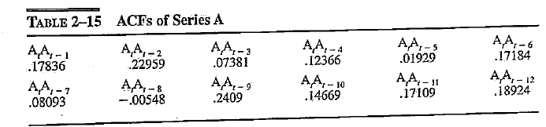
Pattern Recognition with ACFs (Random Time Series)

Slide 35
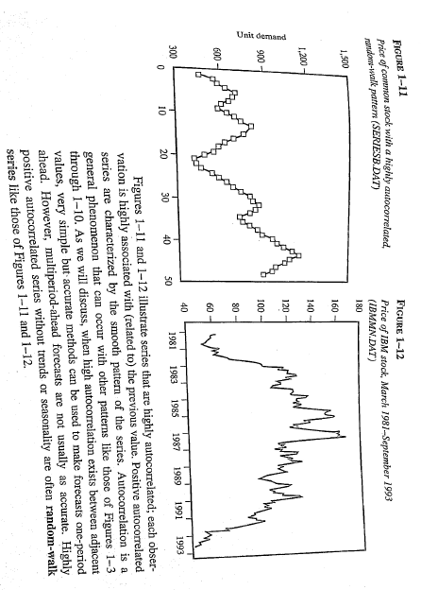
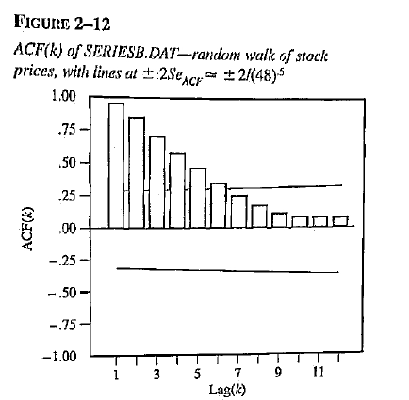
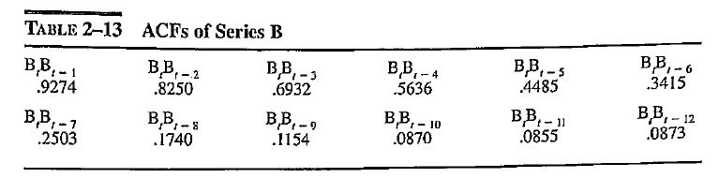
Pattern Recognition with ACFs (Random Walks – randomly walks above and below its overall mean)
Highly auto-correlated
Correlated with preceding value
ACF

Slide 36
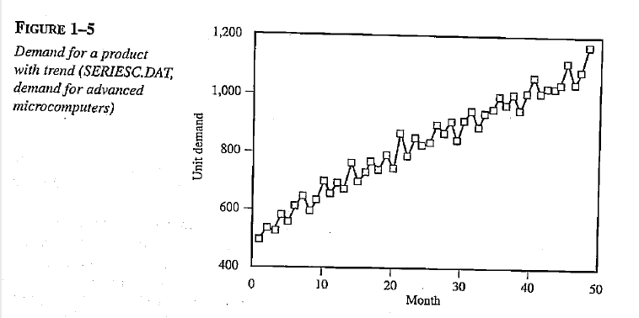
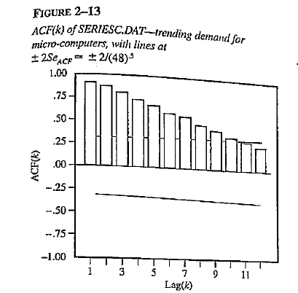
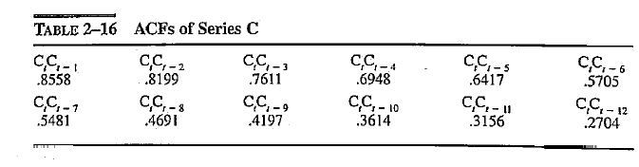
Pattern Recognition with ACFs (Trending Series)
Pronounced trend => extremely high ACFs i.e., adjacent values highly associated with each other, and decline slowly
Trends Vs Random Walks: behaves similarly => t-test done to resolve

Slide 37
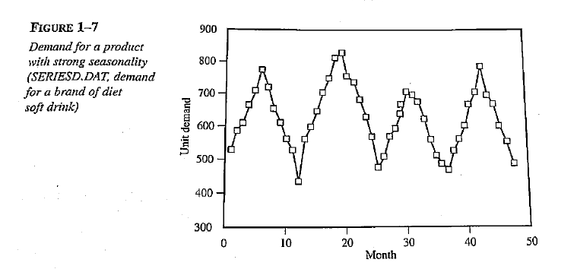
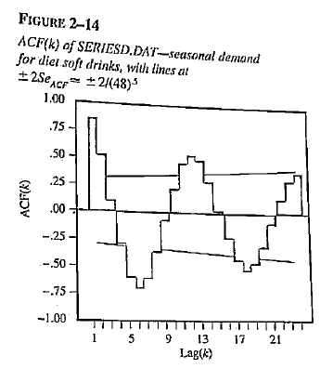
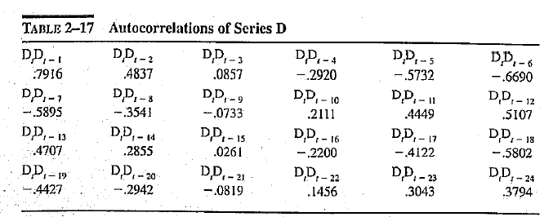
Pattern Recognition with ACFs (Seasonal Series)

Slide 38
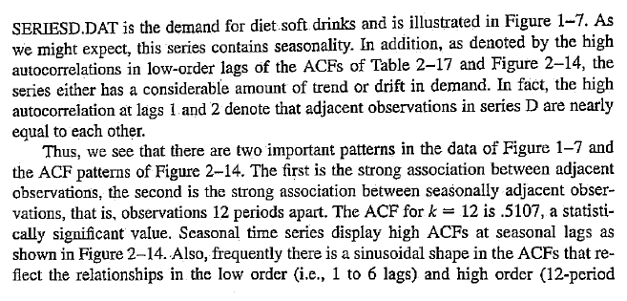
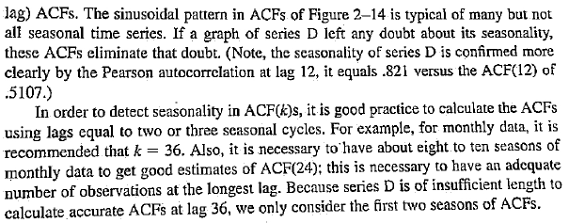
Pattern Recognition with ACFs (Seasonal Series)

Slide 39
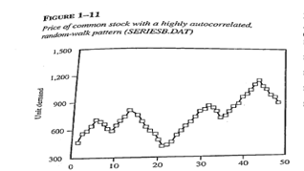
ACFs in Seasonal graphs
NB: Fig 1-11 is not seasonal
(although the graph has a recurring Up and Down Pattern – Why?)
It does not have a constant period between peaks and troughs as in the 12-period
Pattern of Fig 1-7

Slide 40
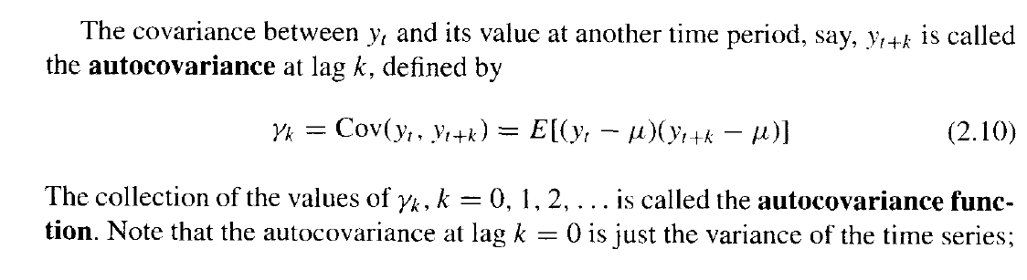
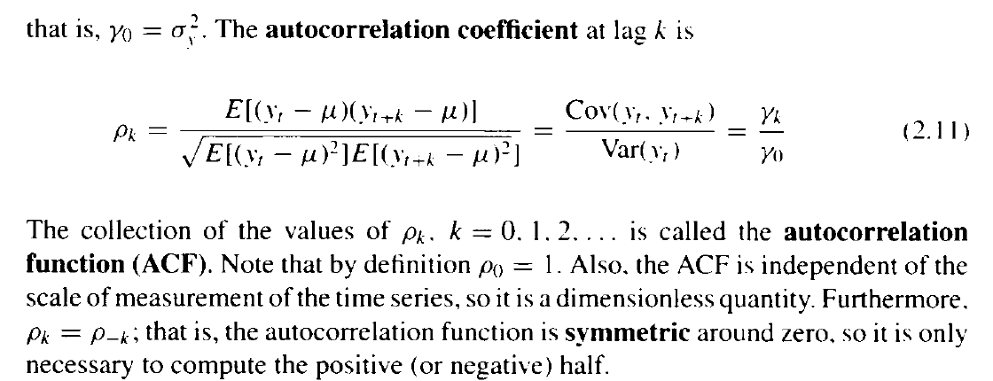
Auto-covariance at lag k

Slide 41
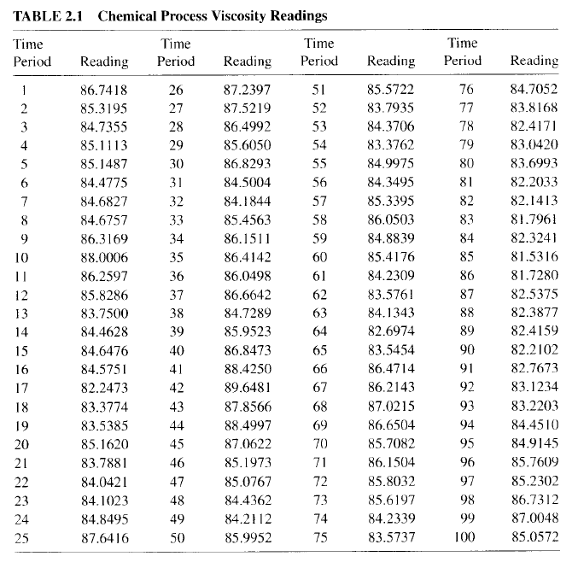
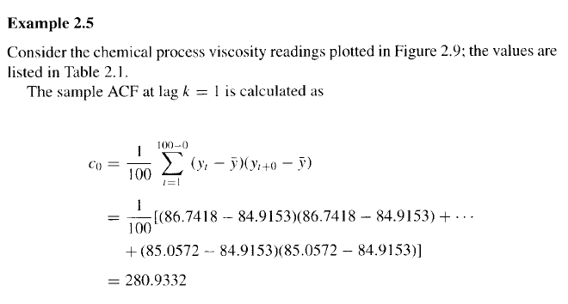
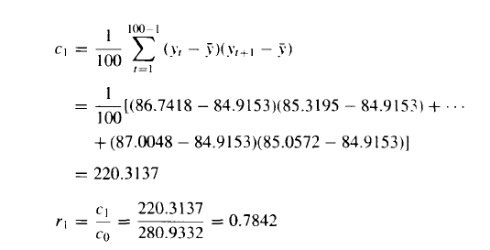
Sample Auto Correlation Function(ACF)

Slide 42
Autocorrelation of Stationary Time Series

Slide 43
Stationary Time Series…recap

Slide 44
Stationary Time Series
observations =>
the time series is strictly stationary.
Note that both time series seem to vary around a fixed level => this is a characteristic of
stationary time series.

Slide 45
Stationary Time Series
Stationary implies a type of statistical equilibrium or stability in the data. Consequently, the time series has a constant mean defined in the usual way as

Slide 46
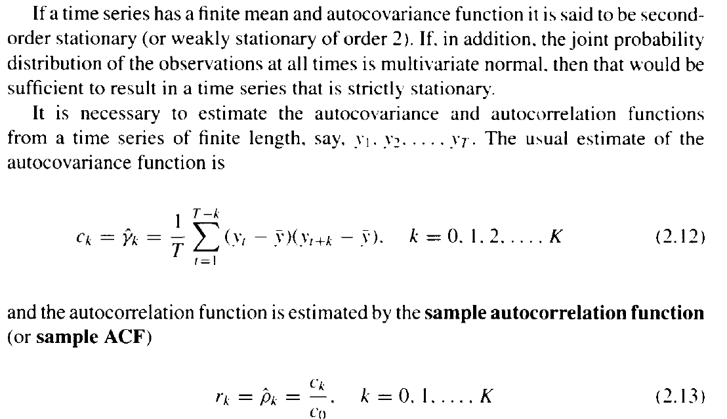
Weakly/ Strictly Stationary
A good general rule of thumb is that at least 50 observations are required to give a
reliable estimate of the ACF, and the individual sample autocorrelations should be
calculated up to lag K, where K is about T/4.

Slide 47
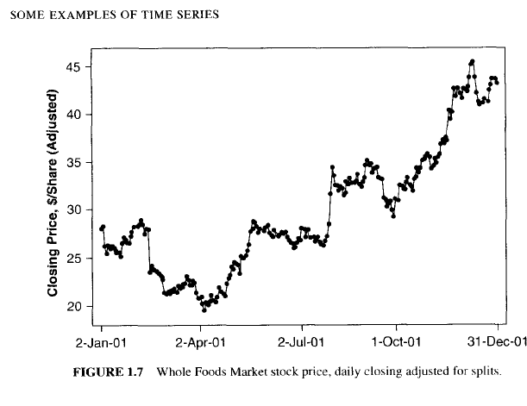
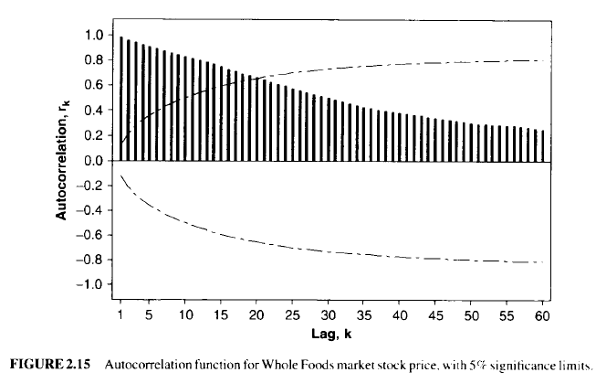
Sample ACF of a Nonstationary time series
While the autocorrelation function is defined only for a stationary time series, the
sample ACF can be computed for any time series
Note that this sample ACF plot behaves quite differently than the ACF plots in Figures 2.12 and 2.14. Instead of cutting off or tailing off near zero after a few lags, this sample ACF is very persistent; that is, it decays very slowly and exhibits sample autocorrelations that are still rather large even at long lags. This behavior is characteristic of a nonstationary time series.

Slide 48
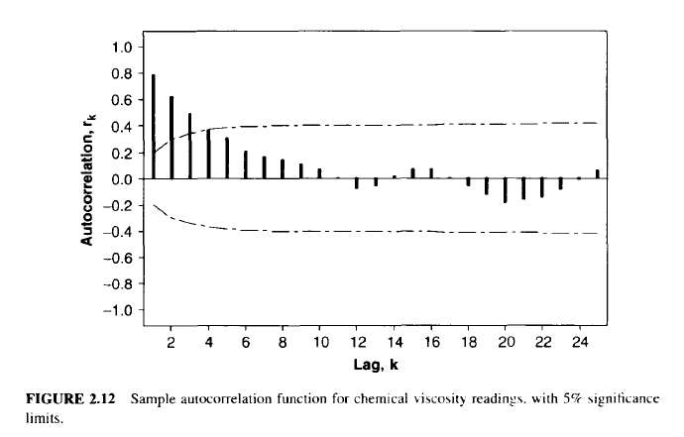
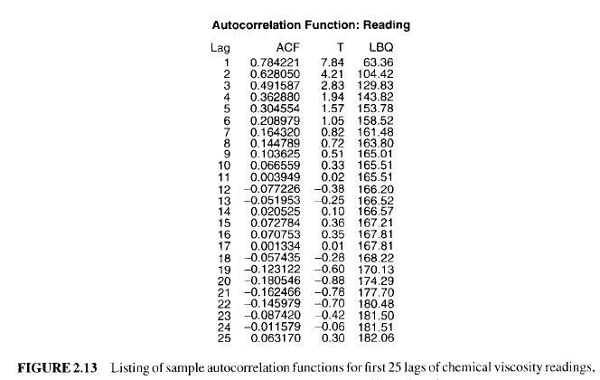
Sample Auto Correlation Function(ACF)
Note the rate of decrease or decay in ACF values in Figure 2.12 from 0. 78 to 0, followed by a sinusoidal pattern about 0. This ACF pattern is typical of stationary time series.

